Slide 1
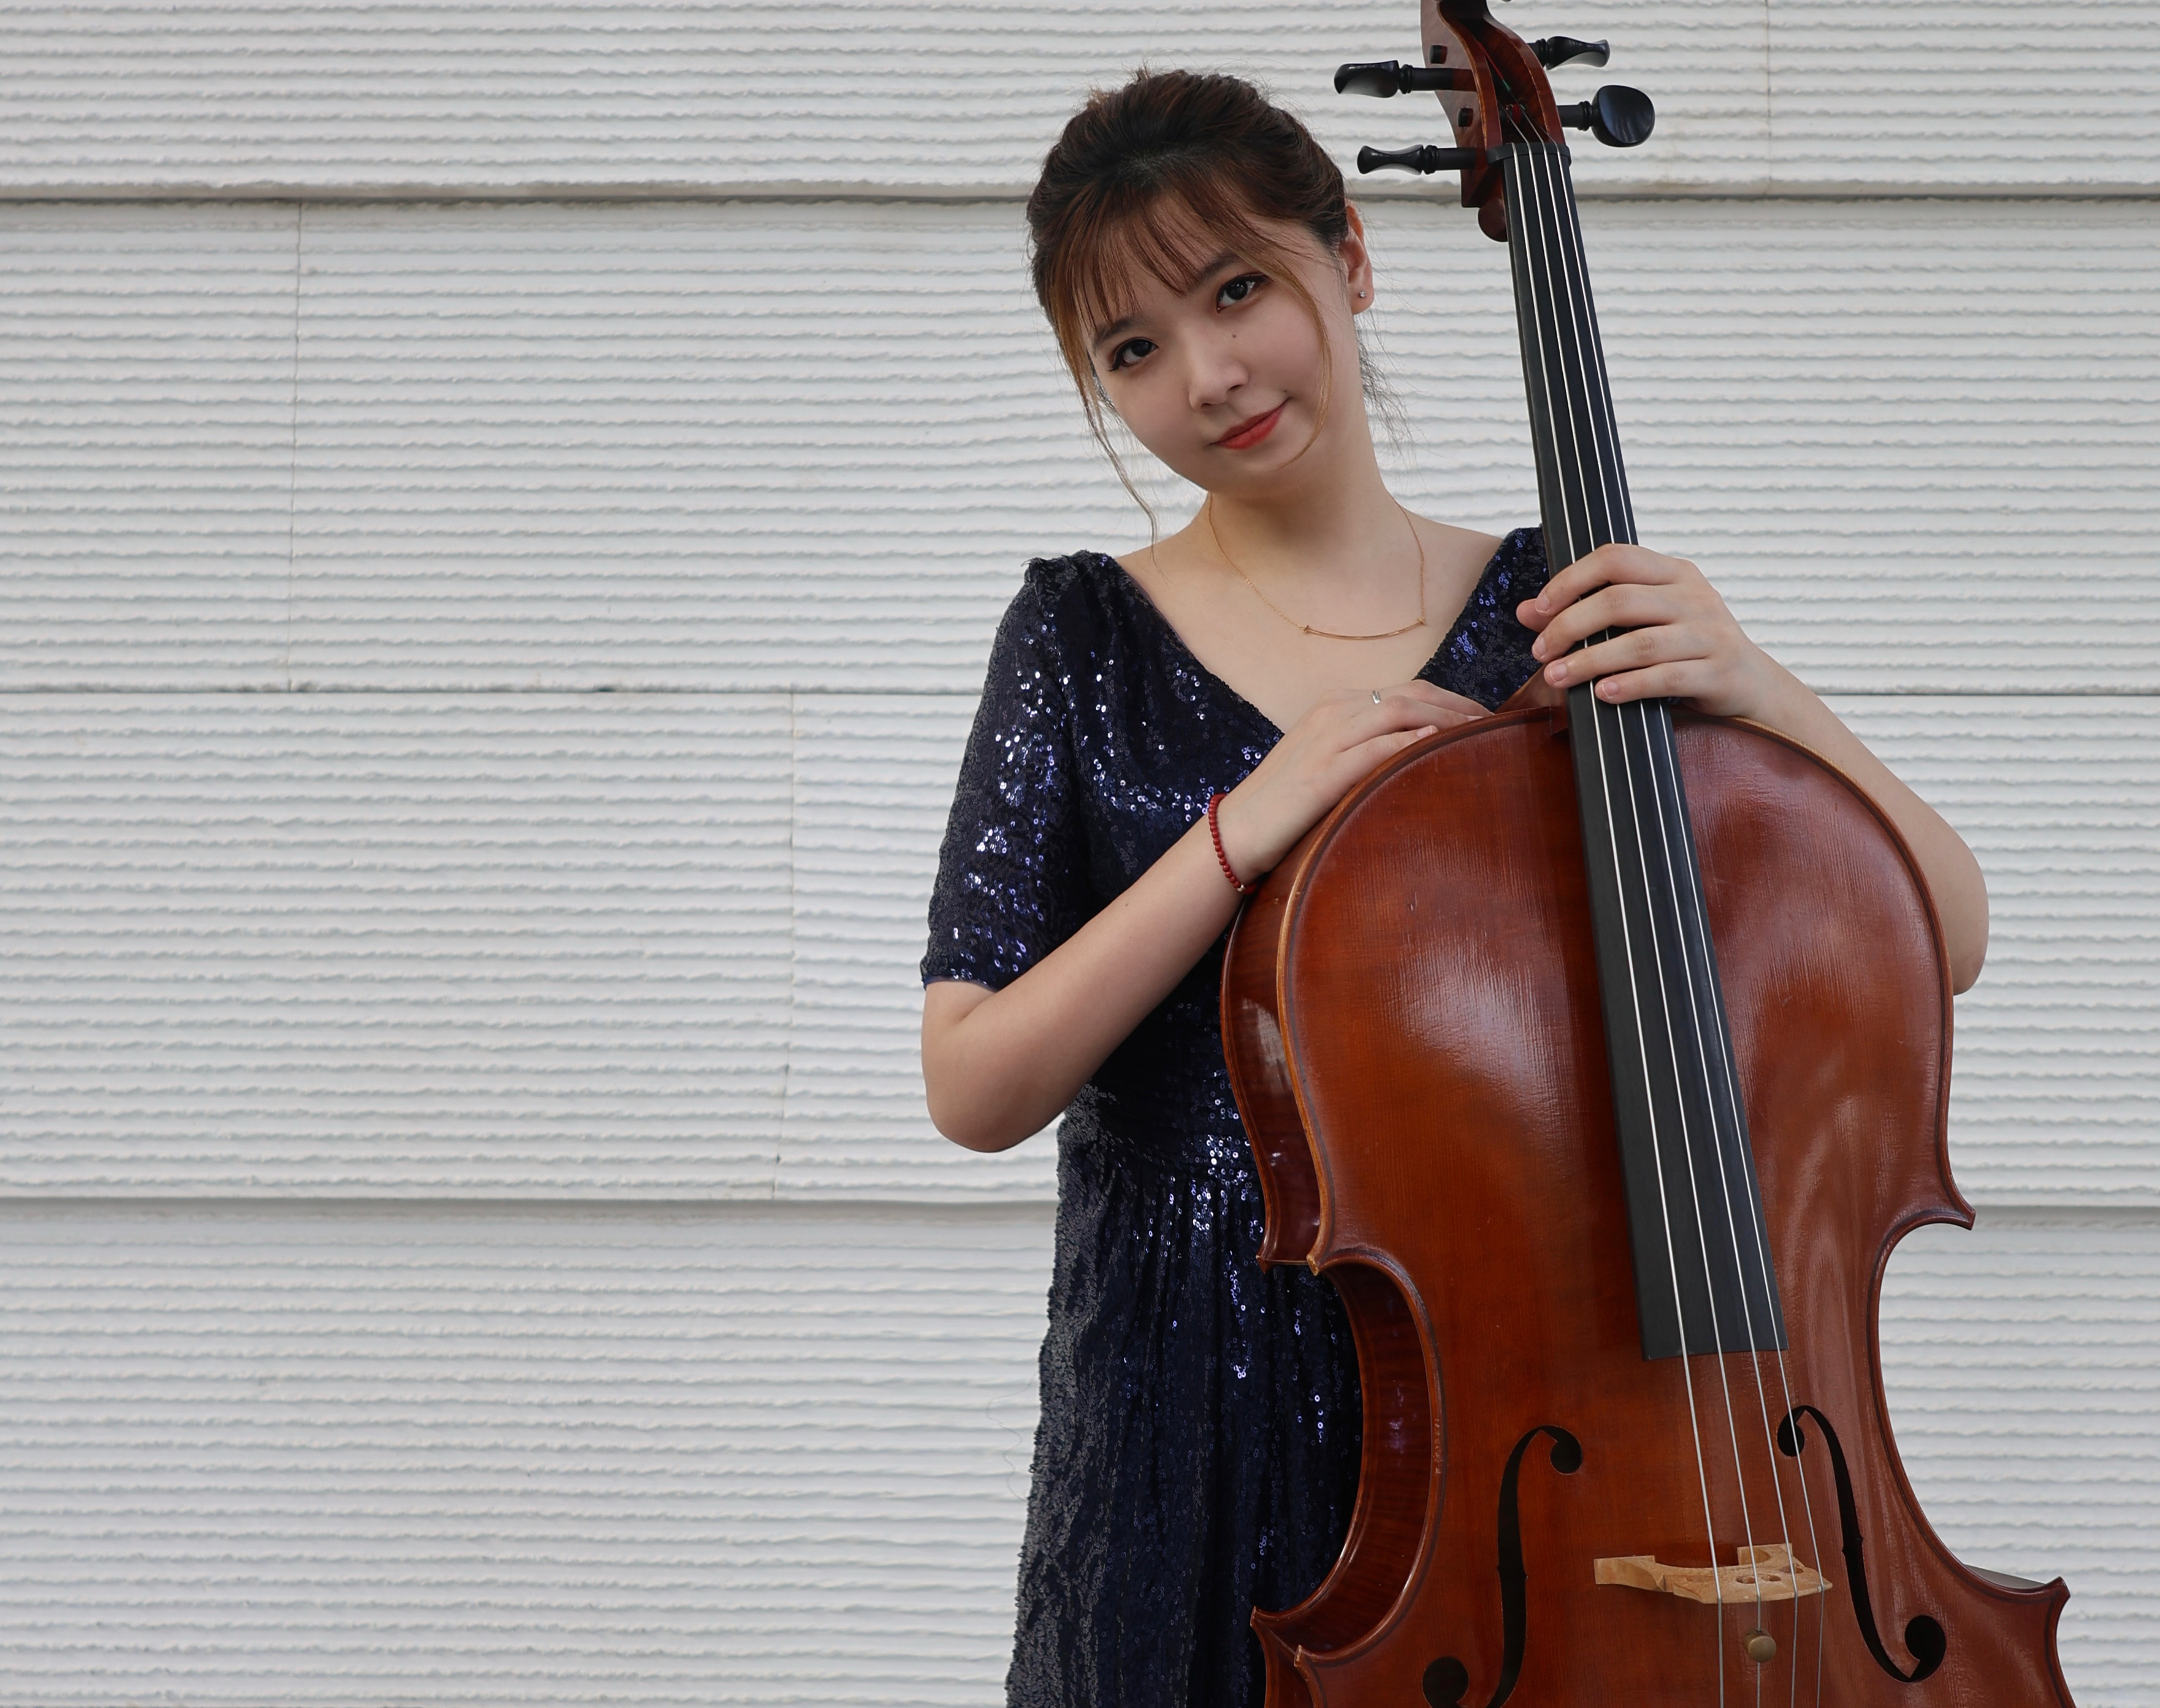
Liu Yubin Cello Junior Recital
Program Note
Location: Yong Siew Toh Conservatory of Music
Time: 26th, Nov. 2025, 2:40-3:10 PM

Slide 2
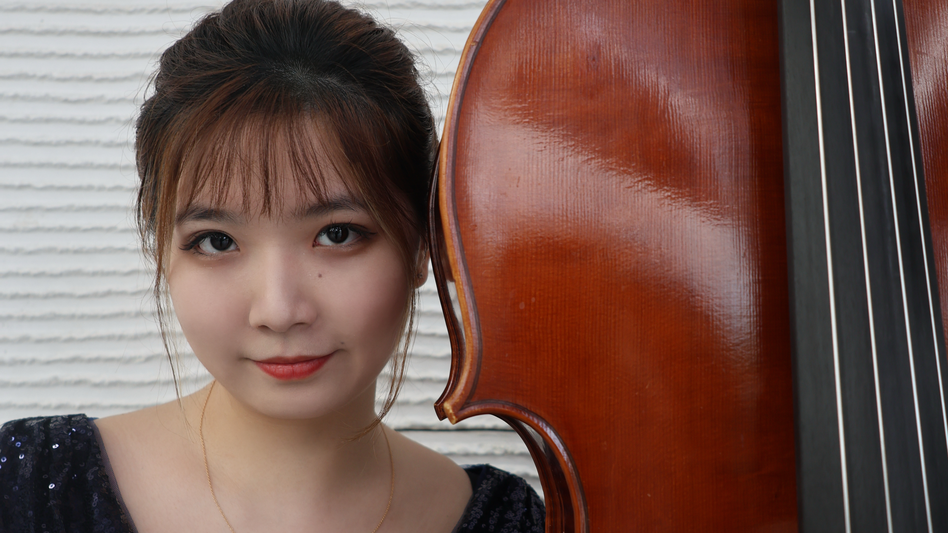
Yubin’s Bio
My name is Liu Yubin, I was born in Beijing, China in 2004. I started learning piano at the
age of 4 and cello at the age of 6. I studied under the famous cello educator Professor Na
Mula of the Central Conservatory of Music. In 2013, I was admitted to the Central
Conservatory of Music Primary school with the first place. I studied under Associate
Professor Wang Chongwu of the Central Conservatory of Music Middle School, and also
studied with Zhao Yunpeng, principal cellist of the China Philharmonic Orchestra, and
graduated with excellent results. Starting from 2023, I will study at the Yong Siew Toh
Conservatory of Music at the National University of Singapore with a full scholarship, studying under Professor Qin Liwei. Liu Yubin had excellent academic performance while at school and won the Excellence
Award in the Scholarship Competition of the Central Conservatory of Music Middle
School. In 2014, I won the fourth prize in the professional group of the "Aegean Cup"
International Cello Competition. In 2019, I won the third prize in the Inner Mongolia
International Music Summer Camp-Cello Professional Group Competition. The string
quartet formed by four students won the second prize in the ensemble competition held
by the school. I was selected into the "Genius Youth Troupe" of the Central Conservatory
of Music Middle School and went to Yan’an, Hohhot and other places to perform with the
troupe. I traveled to Europe with the Youth Symphony Orchestra of the Central
Conservatory of Music Middle School, and represented the school in various important
state performance tasks. I performed many times in the Golden Hall of the Great Hall of
the People, the National Center for the Performing Arts, and the Beijing Concert Hall.

Slide 3
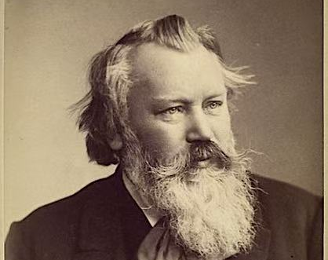
Program
Johannes Brahms: Sonata for Cello and Piano in F Major, No.2, op.99
Allegro Vivace
Adagio Affettuoso
Allegro Passionato
Allegro Molto

Slide 4
I. Allegro Vivace
The Allegro vivace is a sonata form opening with a fragmented cello theme over a tremolo piano part. Its bipartite exposition somewhat unusually traverses F major, C major, and A minor; Roger Graybill argued that the tonal plan may be read as ultimately returning to F major, given the intricate motivic structure of its voice leading.

Slide 5
II. Adagio Affettuoso
Deeply felt, introspective, and sorrowful. "Affettuoso" implies a tender, heartfelt passion, and this movement is the emotional heart of the sonata. It's in the dark, remote key of F-sharp minor, which gives it a haunting quality.

Slide 6
III. Allegro Passionato
A fiery, turbulent scherzo. This is one of Brahms' most demonic and driven movements. The "passionato" marking is key—this is not playful, but fierce, rhythmic, and explosive.

Slide 7
IV. Allegro Molto
A brilliant, joyful, and virtuosic rondo. After the intensity of the first three movements, the finale provides a triumphant and sunny release. It's mostly light-hearted and playful, with a folk-dance-like quality.

